Slide 1
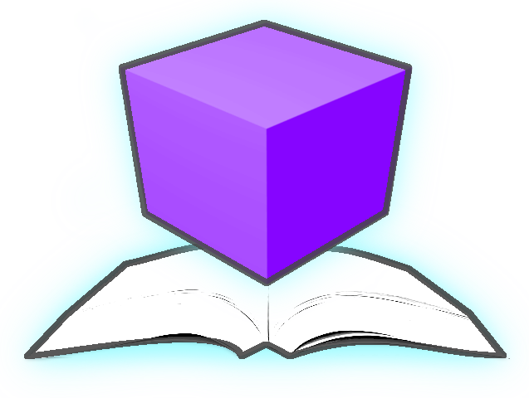
Diagram
Animation and
Visualization
Environment
Group 02

Slide 2
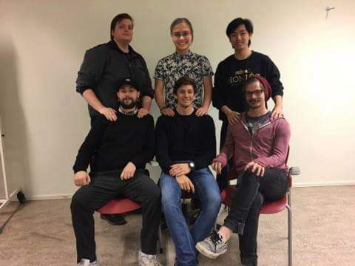
ABOUT US
ELAINE QVARNSTRÖM
ERIK LAURIN
SHAUN MCMURRAY
BOYAN DAI
JOACIM EBERLÉN
JUSTINAS STIRBYS

Slide 3
PROJECT
AUDIENCE
Main idea
Visualize and simulate UML Diagrams in 3D
Group rooms
Instructor
Publishes diagram
Student
Subscribes to group room
Instructors, students and people working with UML
Purpose:
Acquire knowledge with physical/tangible objects
Gamified learning
Distributed simulation
See active students
High accessibility

Slide 4
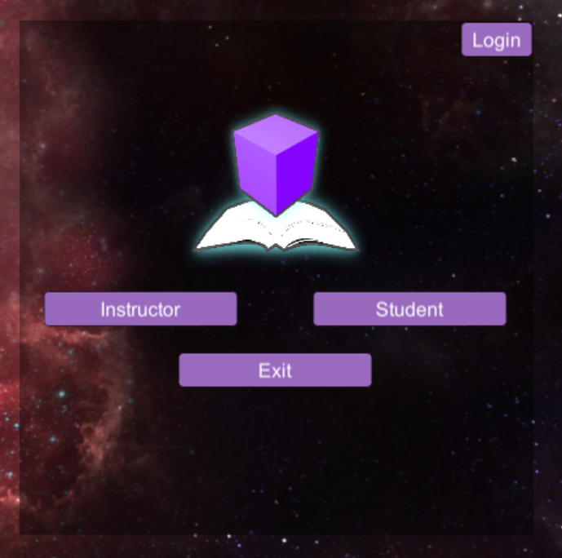
User’s perspective
‘student’

Slide 5
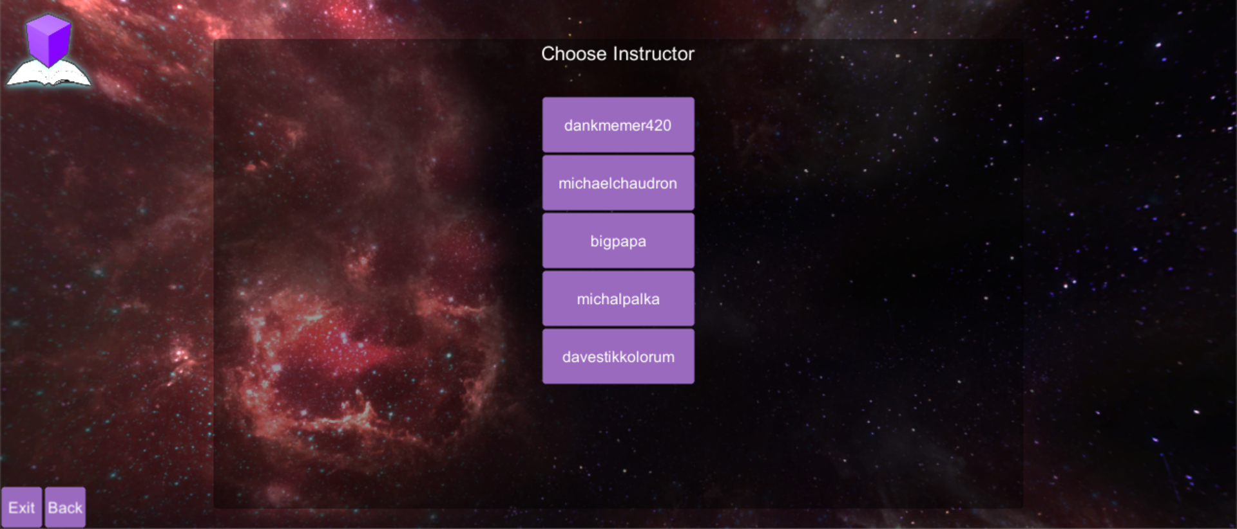
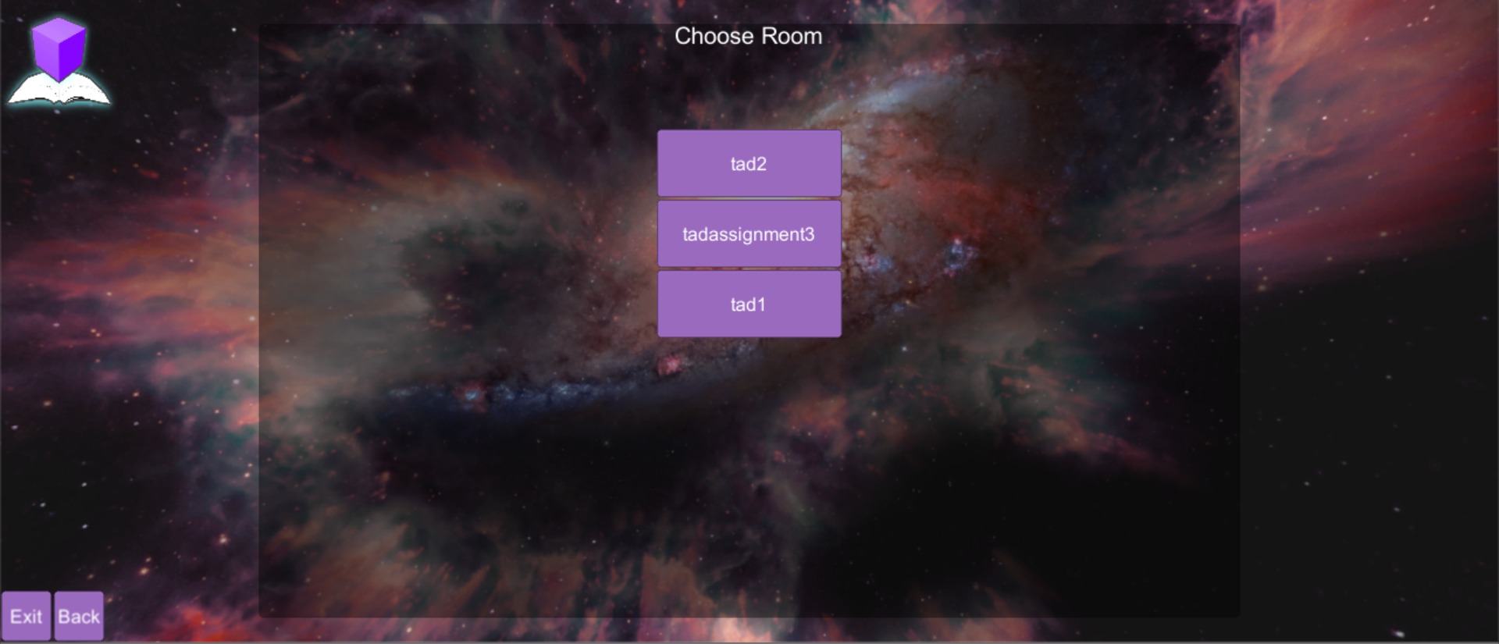

Slide 6
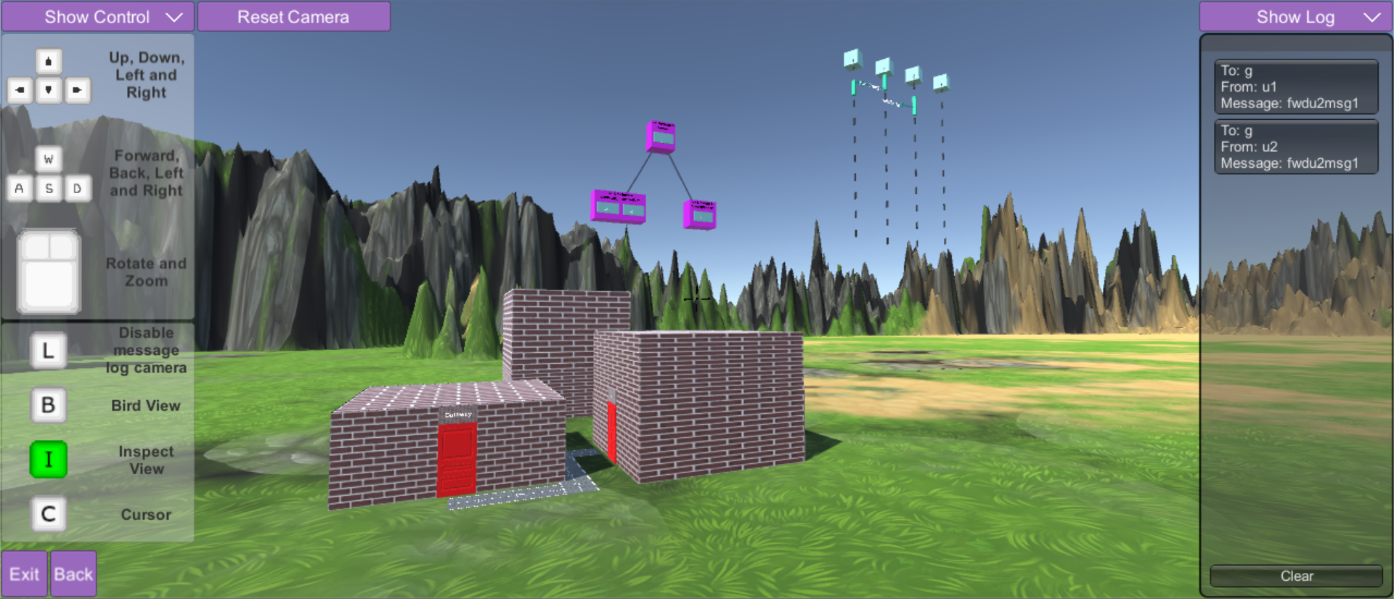

Slide 7
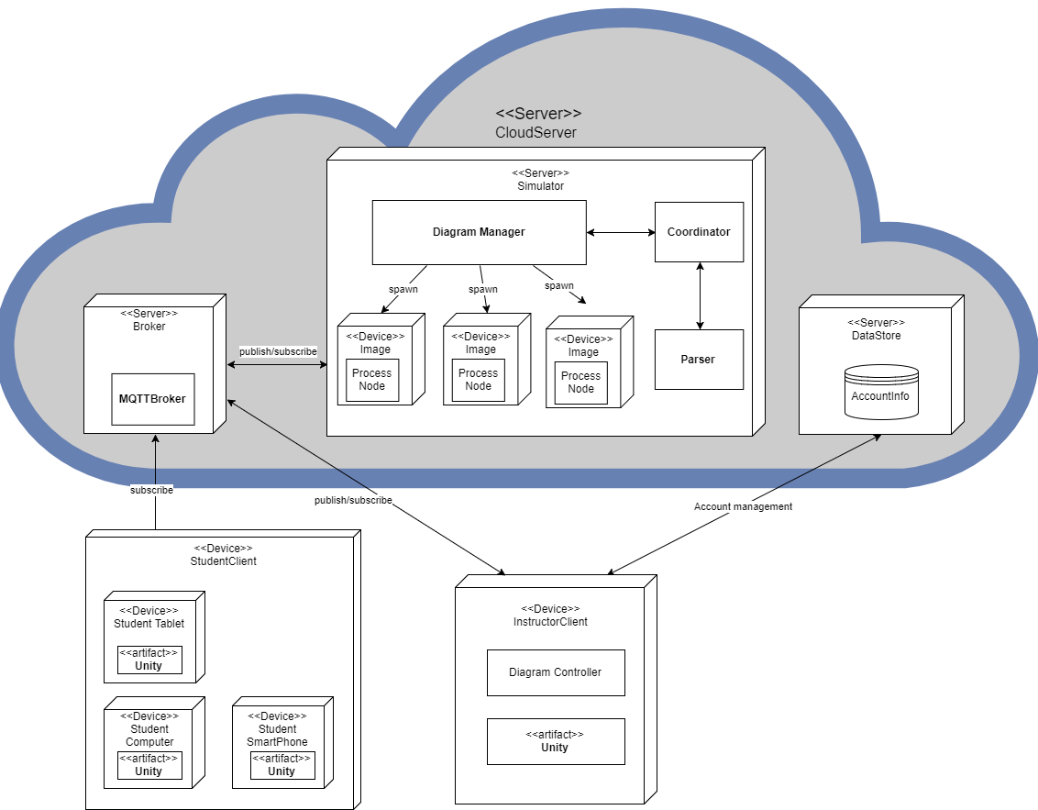
Deployment Diagram
Architecture

Slide 8
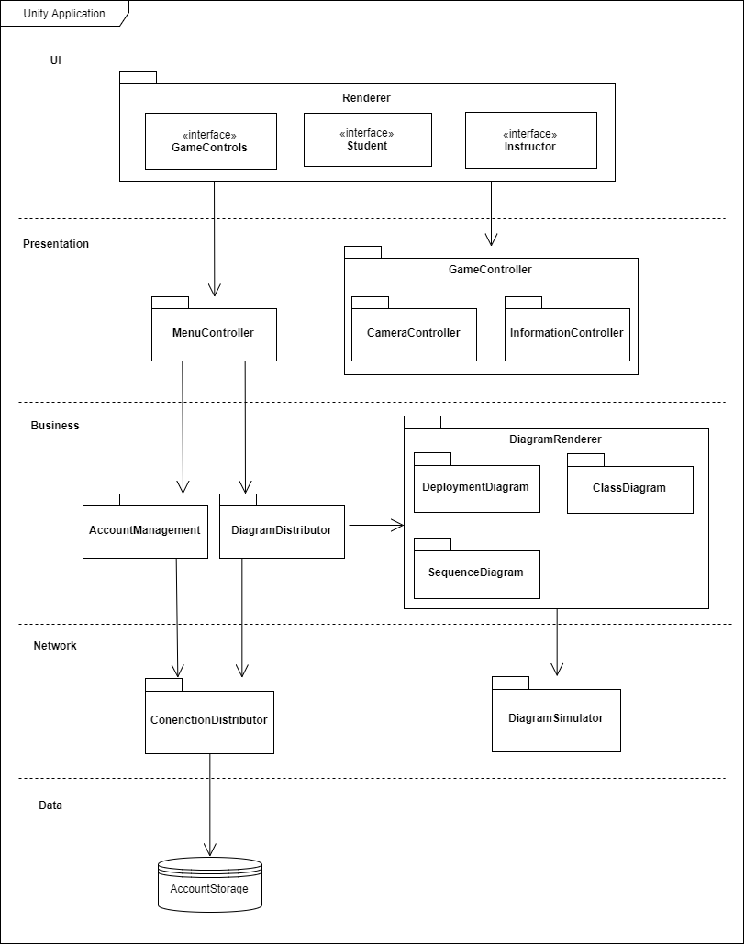
Package Diagram
Architecture

Slide 9
Thank you!
for the mandatory participation

